Slide 1


What is the signature of a trion in ARPES?
Jinyuan Wu, Zachary H. Withers, Thomas K. Allison, Diana Y. Qiu
03/17/2026
Denver, APS March Meeting, MAR-G45

Slide 2
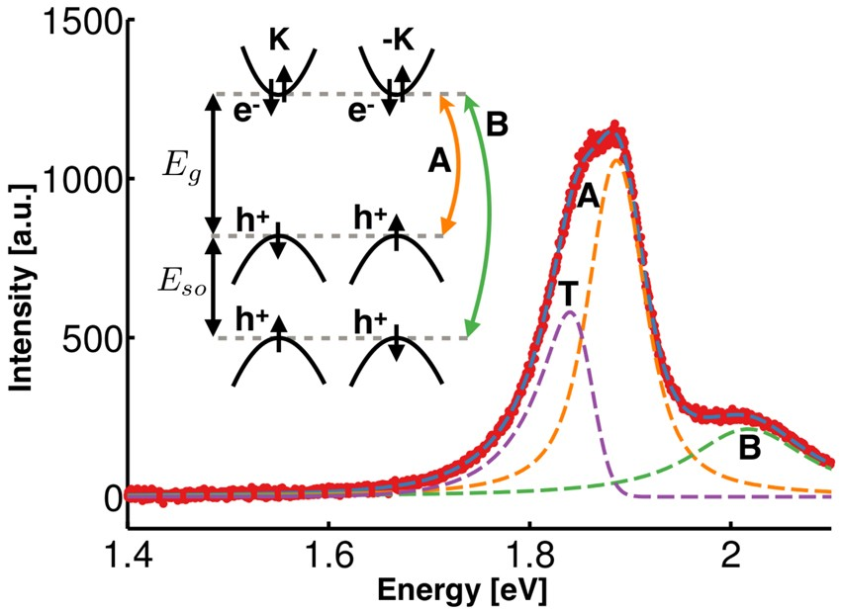
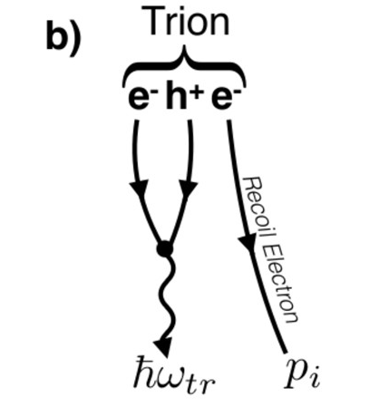
Trions, and where to find them
Trion: “charged exciton”, i.e. an exciton plus an electron/hole
Expected to exist in weakly doped excitonic materials (e.g. TMDs)
Experiment
Doping ⇒ trion formation, splitting of PL peak
Electron left behind steals energy ⇒ asymmetric lineshape
Not unique for trions
Christopher et al. Sci Rep 7, 14062 (2017), among others
photoluminescence (PL) spectroscopy in monolayer MoS₂
Energy conservation
+

Slide 3
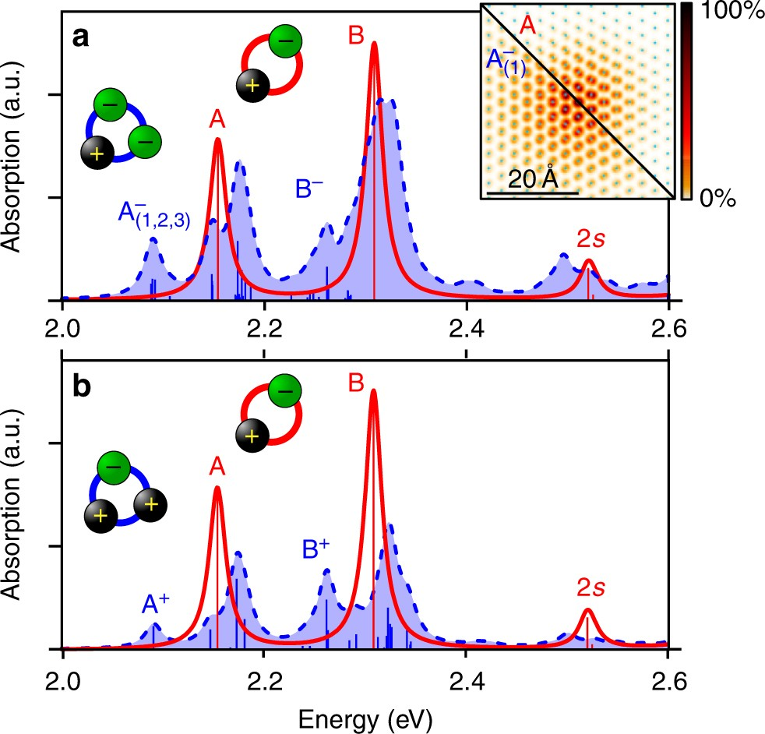
Question: do we have more solid indication of trion formation?
Trions, and where to find them
We do see redshifted peaks in trion BSE…
But other excitations have this trait too!
Theory: trion BSE
Experiment
Drüppel et al. Nat. Comm. 8 2117 (2017)
absorption spectroscopy in monolayer MoS₂
Christopher et al. Sci Rep 7, 14062 (2017), among others
photoluminescence (PL) spectroscopy in monolayer MoS₂

Slide 4
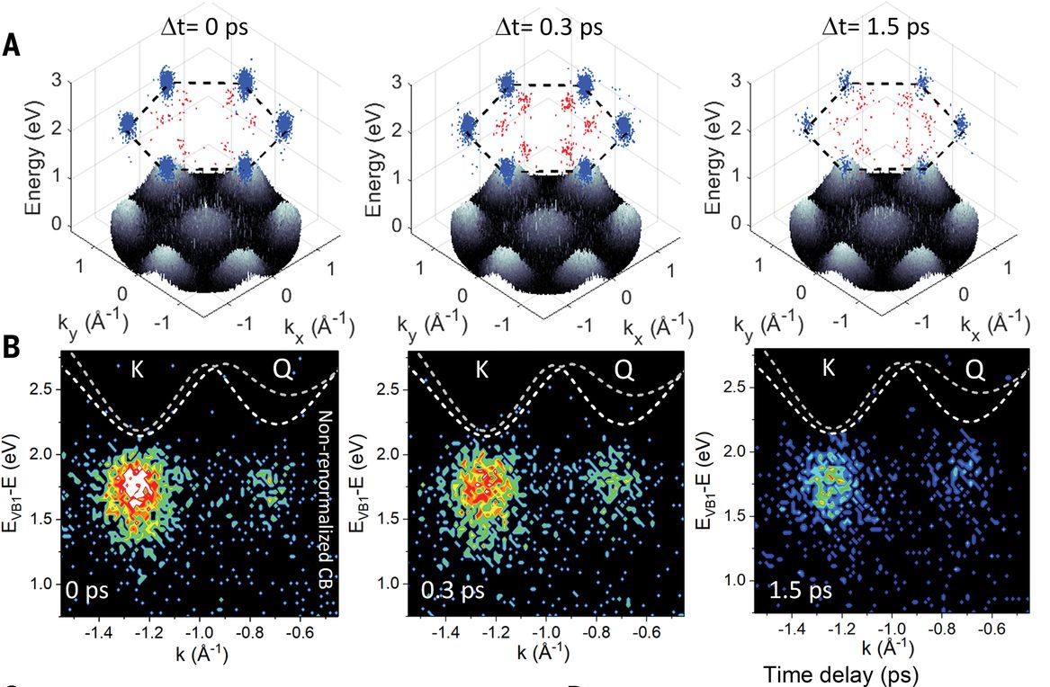
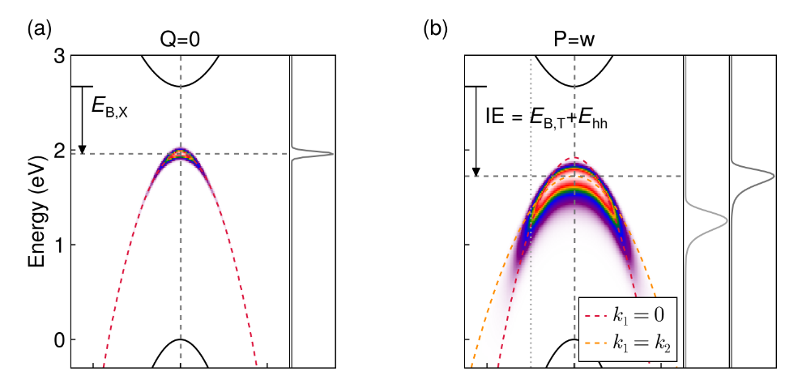
ARPES observation of excitons
Already done in experiments (Madéo et al., Science, 370(6521), pp.1199-1204)
Exciton Boltzmann transport observed (cf. theory in e.g. Chen et al. PR Research 2022 4(4):043203)
Here is a what an exciton look like in ARPES…
Cf. Rustagi and Kemper PRB 97, 235310
Question: what does a trion look in in this experimental setup?

Slide 5
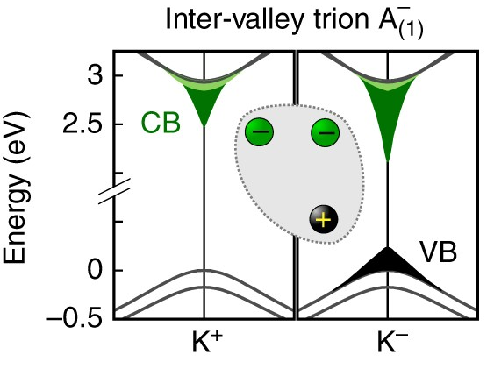
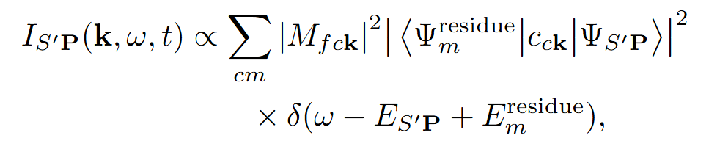




Outline of this project
Trion initial state
Fermi golden rule for (incoherent) ARPES
Residue calculation
1s
2p
e2
e1
h
2p
2s
Become photoelectron
K’
K
residue state
Drüppel et al. Nat. Comm. 8 2117 (2017)
Qiu et al. PRL 115, 176801 (2015)

Slide 6
Outline of this project
Trion initial state
Fermi golden rule for (incoherent) ARPES
Residue calculation
1s
2p
e2
e1
h
2p
2s
Become photoelectron
K’
K
residue state
Drüppel et al. Nat. Comm. 8 2117 (2017)
Qiu et al. PRL 115, 176801 (2015)

Slide 7
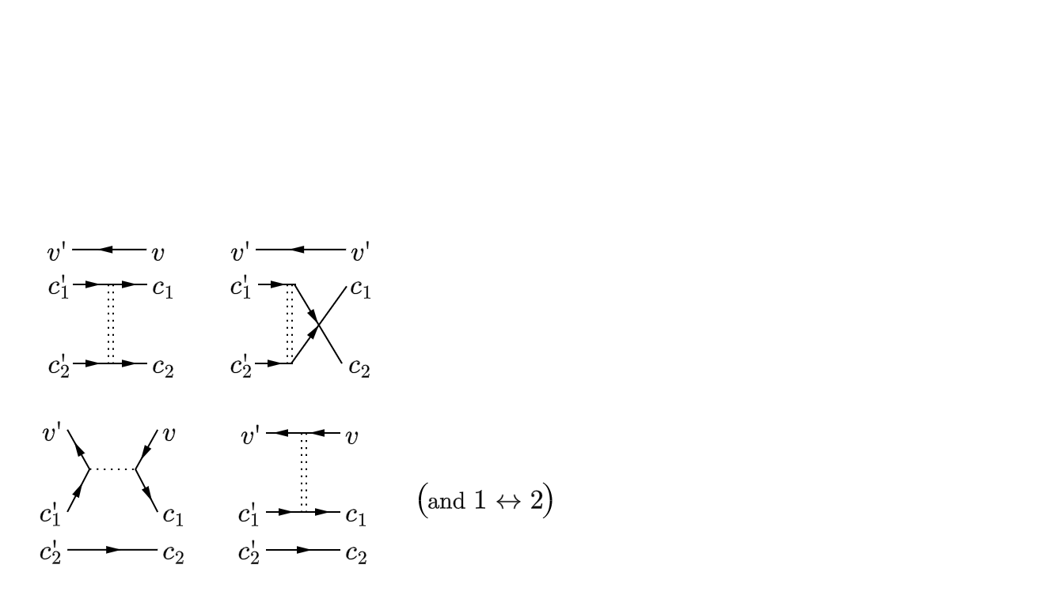
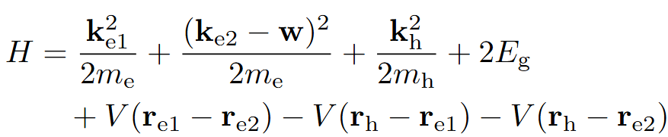
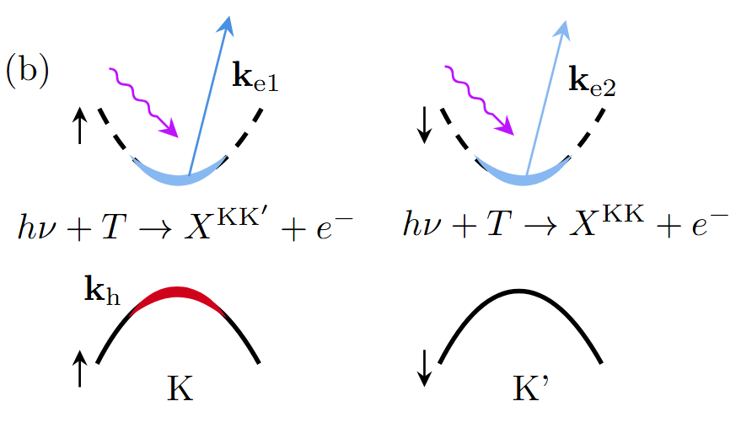


Trion in monolayer MoS₂
BSE for trions: Druppel et al. Nat. Comm. 8 2117 (2017)
Using a two-band model to capture this mode
Lowest trion (Tempelaar and Berkelbach Nat Commun 10, 3419 (2019)):
Intervalley to reduce Coulomb repulsion
Spin-valley locking
Spin(and valley)-singlet state reduces exchange term
Chandrasekhar’s H⁻ ansatz (Berkelbach et al.PRB 88, 045318)
$a$ = 10.3 Å $b$ = 25.2 Å
$b$
e
$a$
h
e

Slide 8
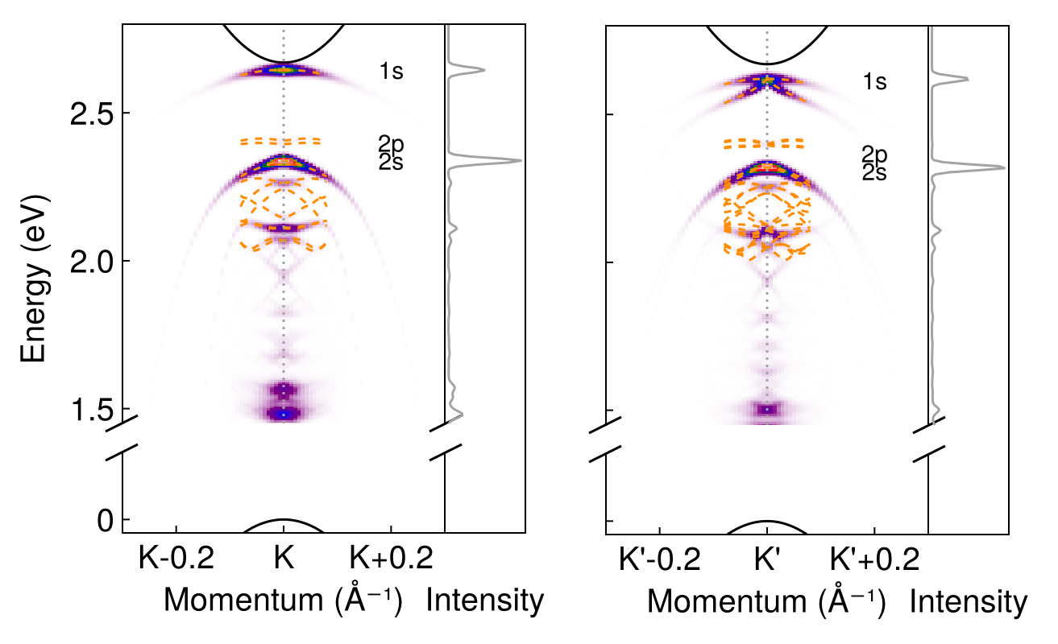
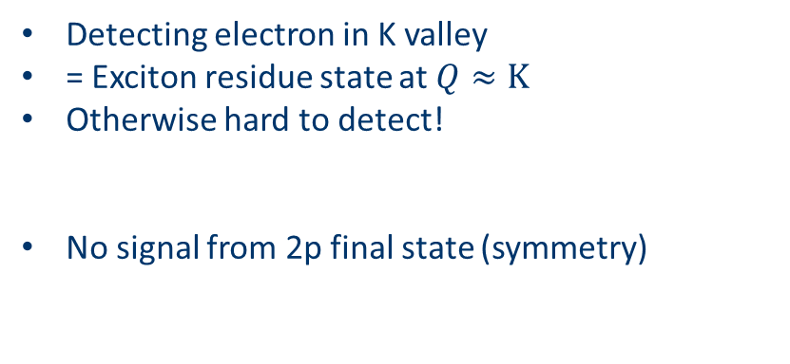
ARPES signal from negative trion
1s
Detecting electron in K valley
= Exciton residue state at $Q≈K$
Otherwise hard to detect!
No signal from 2p final state (symmetry)
2p
2s

Slide 9
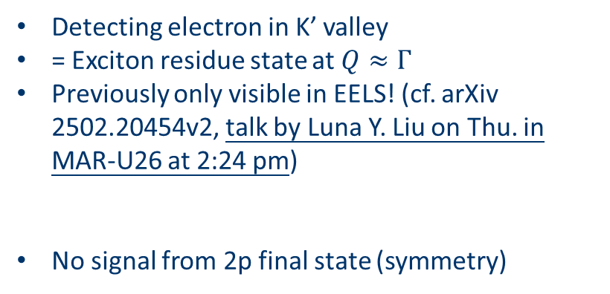
ARPES signal from negative trion
1s
Detecting electron in K’ valley
= Exciton residue state at $Q≈Γ$
Previously only visible in EELS! (cf. arXiv 2502.20454v2, talk by Luna Y. Liu on Thu. in MAR-U26 at 2:24 pm)
No signal from 2p final state (symmetry)
2p
2s

Slide 10

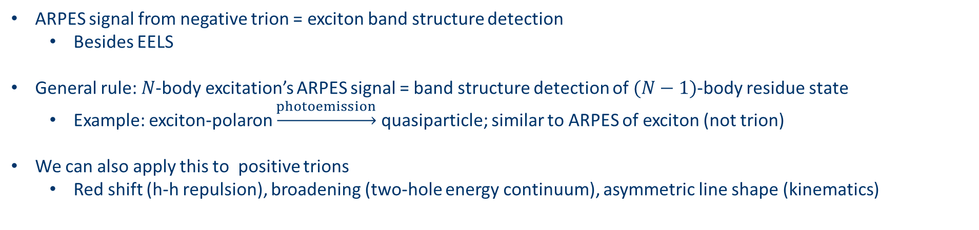
Comparison between ARPES signals
ARPES signal from negative trion = exciton band structure detection
Besides EELS
General rule: $N$-body excitation’s ARPES signal = band structure detection of $(N−1)$-body residue state
Example: exciton-polaron $\underset{→}{photoemission}$ quasiparticle; similar to ARPES of exciton (not trion)
We can also apply this to positive trions
Red shift (h-h repulsion), broadening (two-hole energy continuum), asymmetric line shape (kinematics)
Negative trion
Exciton (and qualitatively exciton-polarons)
Positive trion

Slide 11
Conclusion
Trions look different from excitons (and other things) in ARPES
ARPES signal of negative trions show exciton band structure
The methodology can be used in other systems
See Wu et al. What is the signature of a trion in photoemission? arXiv 2511.19280

Slide 12










Collaborators
Acknowledgement
Zachary H. Withers
Thomas K. Allison
Diana Y. Qiu
Software packages
Funding sources and supercomputers

Slide 13
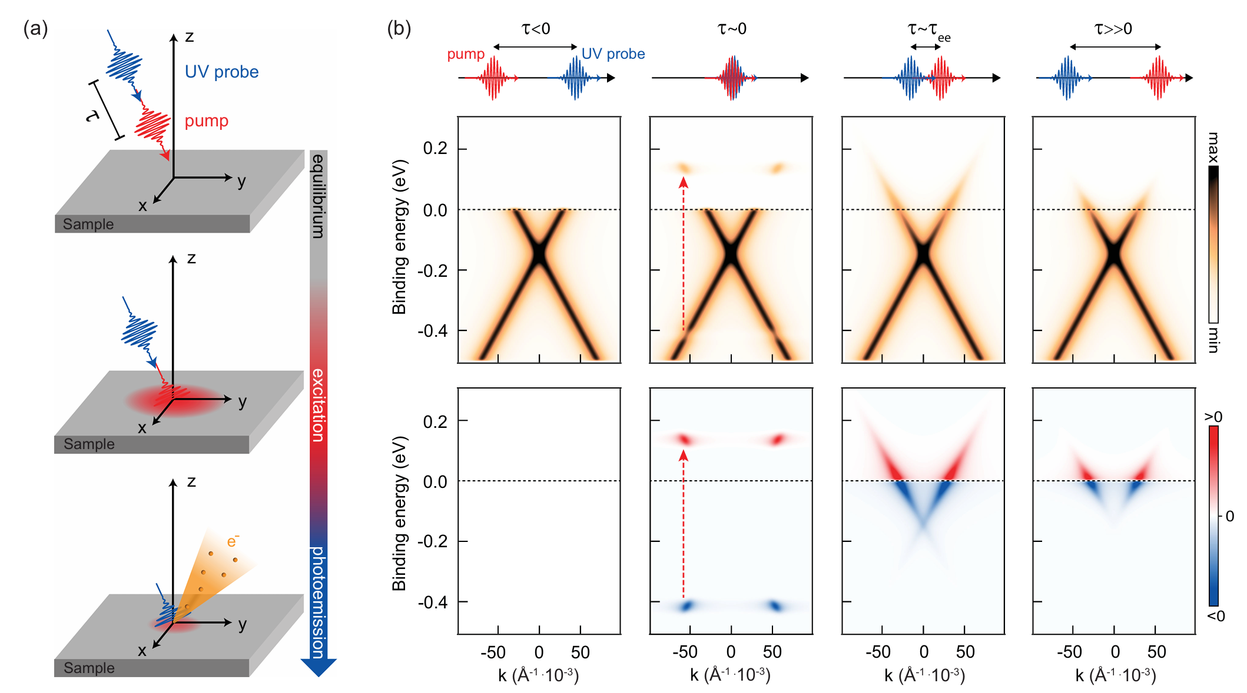
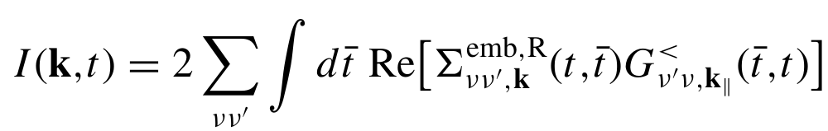
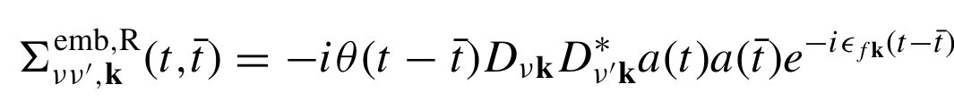
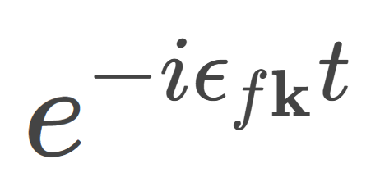
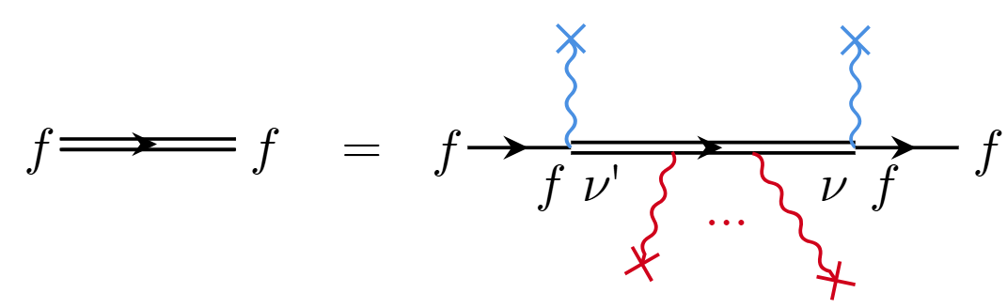
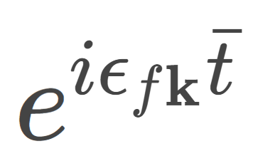
Theory of tr-ARPES
Theory in general: Keldysh EOM. Common scheme (e.g. PRB 94,245303, 2016):
Pump as a part of non-equilibrium EOM
Probe as perturbation on top of everything
RMP 96.1 2024: 015003

Slide 14
Theory of tr-ARPES
Discussed in this talk
Short delay time limit:
Good electronic coherence
Floquet renormalization
To be handled within coherent quantum master equation (e.g. PNAS 120.32 (2023): e2301957120)
Long delay time limit i.e. incoherent limit:
Decoherence
(Quasi-)thermalized electronic excitations
This is what we see in tr-ARPES measure of composite excitations
RMP 96.1 2024: 015003

Slide 15
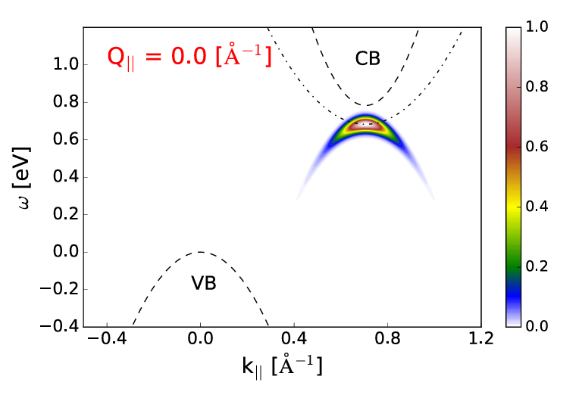
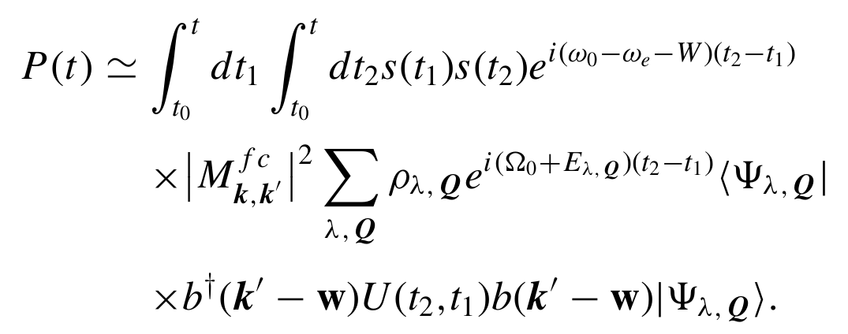
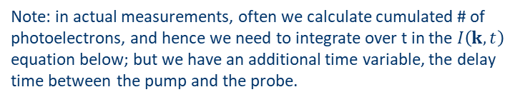

ARPES observation of excitons
Theory of exciton signature in ARPES: Rustagi and Kemper 2018 PRB 97, 235310
The $D^{∗}D$ term
Incoherent limit: no non-diagonal terms in density matrix
PRB 94,245303, 2016
Note: in actual measurements, often we calculate cumulated # of photoelectrons, and hence we need to integrate over t in the $I\left(k, t\right)$ equation below; but we have an additional time variable, the delay time between the pump and the probe.
How other excitations look like in ARPES?

Slide 16
Trion structure: BSE prediction
Generalizing BSE for excitons to trions: Druppel et al. Nat. Comm. 8 2117 (2017)
Difference from exciton BSE: the “exchange” term between two electrons (cf. u-channel in particle physics)
“The diagonalization of the trion Hamilton matrix is numerically extremely demanding due to the immense dimension of ~107 for a typical calculation and relies on recursive diagonalization schemes”
Note that it’s not the nonlinear response of TD-aGW

Slide 17
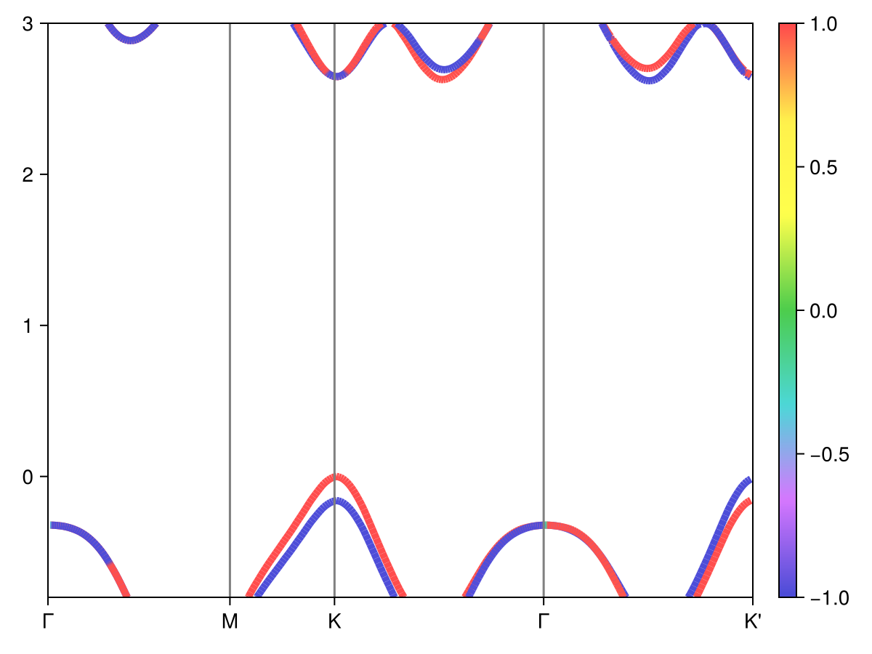
Classification of excitonic states in MoS2
/pscratch/sd/j/jywu/MoS2/MoS2/2-sigma-cutoff-20/inteqp/dft-spin-texture-gw.png
At K,
v1 is spin-up
v2 is spin-down
Near a patch (smaller than the excitonic patch)
c1 is spin-up
c2 is spin-down
Away from the patch
c1 is spin-down
c2 is spin-up
We need to re-arrange the band indices if we want the properties of a single band to be smooth
Pay attention to the band crossing here!!

Slide 18
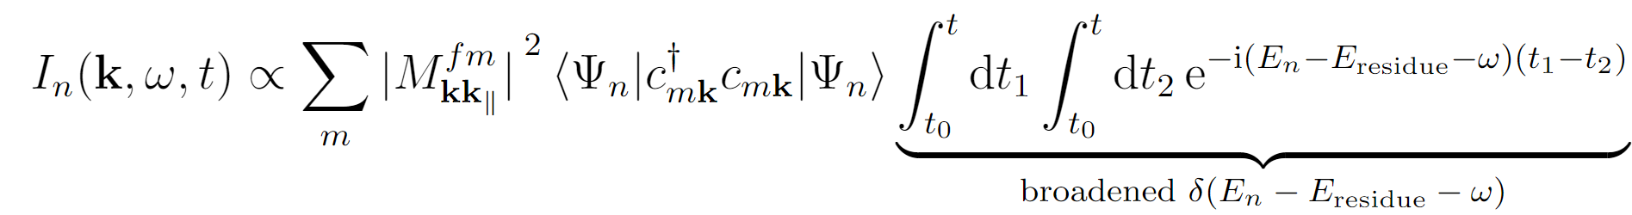
ARPES observation: general theory
To generalize the methodology in Rustagi and Kemper 2018 PRB 97, 235310:
What we can study:
Excitons
Trions
Biexcitons
and more
Keldysh EOM
Linear response in detection
Generalized Fermi golden rule based on pumped $G^{<}$
Incoherent limit
Fermi golden rule to incoherent final states
structural factor
Energy conservation
Here the final residue states need to have well-defined energies… a condition that’s not always non-controversial

